Slide 1
AP Curriculum Guide
I. Britain’s desire to maintain a viable North American empire in the face of growing internal challenges and external competition inspired efforts to strengthen its imperial control, stimulating increasing resistance from the colonists who had grown accustomed to a large measure of autonomy.
As regional distinctiveness among the British colonies diminished over time, they developed largely similar patterns of culture, laws, institutions, and governance within the context of the British imperial system.
Late 17th century efforts to integrate Britain’s colonies into a coherent, hierarchical imperial structure and pursue mercantilist economic aims met with scant success due largely to varied forms of colonial resistance and conflicts with American Indian groups, and were followed by nearly a half-century of the British government’s relative indifference to colonial governance.
Resistance to imperial control in the British colonies drew on colonial experiences of self-government, evolving local ideas of liberty, the political thought of the Enlightenment, greater religious independence and diversity, and an ideology critical of perceived corruption in the imperial system.

Slide 2
Colonial Economics
European countries competed for wealth
  Goal was economic self sufficiency using:
    Mercantilism – a closed economic system
    Colonies provide raw materials
    Mother country produces manufactured goods
    Ex: colonies provide timber – England trades finished wood

Slide 3
Mercantilism – a closed economic system
          Manufactured Goods
            Farm implements
            Hardware/clocks/hinges
            Cloth
            Furniture
Colony Mother Country
market for Br goods makes $ selling goods to colonies Northern merchants make money & other countries
  Cities develop
  Emerging plantations in the south
    Cash crops slavery
    Trade protected by British navy
            Raw Materials
            Tobacco, wood, indigo. rice
            Naval supplies/pitch/sail masts (wood)

Slide 4
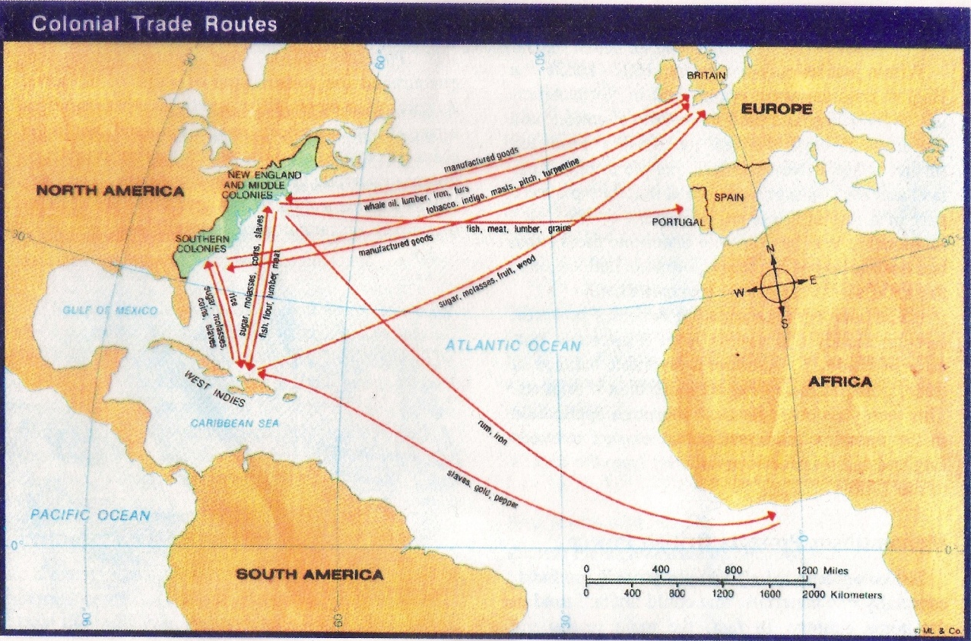
Colonial Trade Routes

Slide 5

Mercantilism
  To compete with the other European nations
Parliament passes the Navigation Acts in 1651
  laws that restricted colonial trade

Slide 6
Navigation Acts of 1660
Laws to regulate trade to decrease smuggling
  1) Had to ship in English ships with 2) ¾ English crews
  3)Certain enumerated goods could only go to England
    Tobacco, rice, indigo, rum
  4) Goods traded between colonies and other European ports had to be first unloaded at English ports – why?
    Overall – they are NOT strictly enforced
    If you mom ignores your late arrival every night even though you have a curfew, what is your attitude going to be?

Slide 7
Salutary Neglect:
As long as the British obtained profits, smuggling was overlooked
SALUTARY NEGLECT = turned a blind eye to this smuggling
  sends a mixed message… Is it ok to smuggle?
If this were your mom or dad when would she start cracking down on you?

Slide 8
Trade Patterns: Triangle Trade
New England
rum
Africa
Sugar
Slaves
Middle Passage
West Indies
Not as simple as it looks!

Slide 9
Triangle Trade
England
New England
Rum, guns
Fish – Mass.
Wheat/flour – NY
Tobacco – VA
Indigo – SC
Rice - GA
Africa
Sugar
Slaves
Middle Passage
West Indies

Slide 10
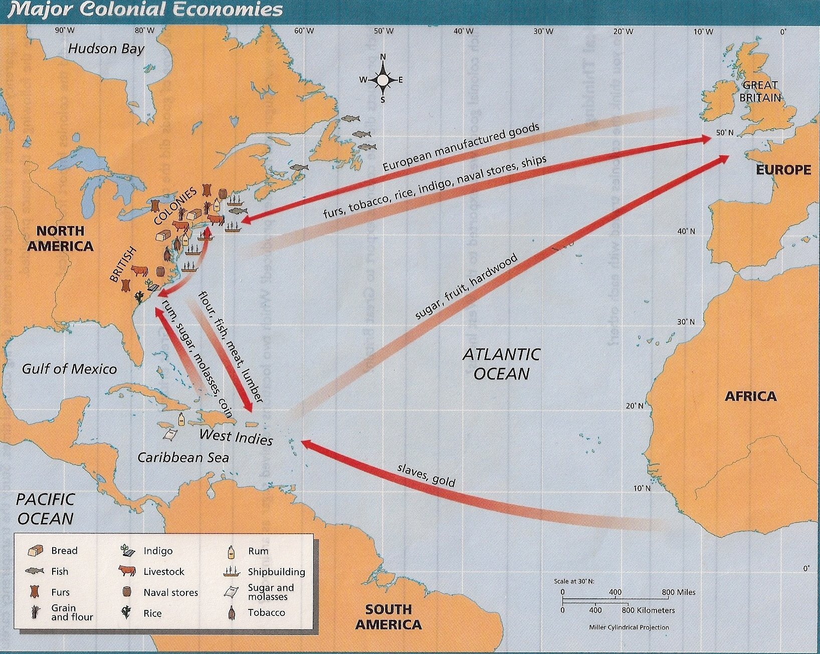

Slide 11
Triangular Trade
A diverse system of trade
1. Finished products (rum) sent from New England to Europe & Africa
2. Once in Africa, slave traders pick up slaves – transport to West Indies.
3. Pick up sugar/molasses for New England where is was distilled into rum.
Pattern repeated itself over and over.

Slide 12

Triangle Trade Routes

Slide 13
Mercantilism
pre-1763
post-1763
salutary neglect
  keep foreign products from competing with Br. goods
colonists are self-governing
pride in being British
DEBT – need money to pay for Fr-Ind War
Br. tries to exert control
increasingly view themselves as separate from Br.

